Slide 1
BJEL1723 ACADEMIC ENGLISH GROUP DISCUSSION
COURSEWORK 1
WEEK 3
30%

Slide 2
FORMAT
Week 3
30%
100 marks
3-4 members in a group
Topic is given on the day of the test
3 Minutes preparation
8-13 Minutes discussion
Notes:
2

Slide 3
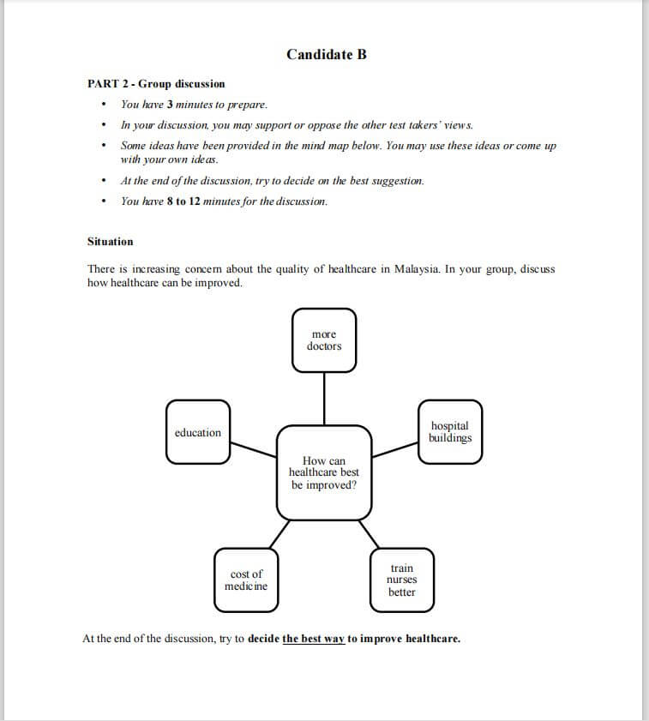
Sample Question

Slide 4

Group Discussion (8-13 minutes)
Initiate a discussion
– Give own opinion.
– Ask other candidates for
their opinions.
– Discuss causes,
effects, problems and solutions.
– Argue and support with evidence.
Maintain a discussion
Close a discussion
– Summarize points argued.
– State consensus of the group.

Slide 5
Roles & Responsibilities
Appoint a facilitator (Open, close and facilitate discussion)
Roles of Members
-Initiate Discussion
-Present an argument
-Asking and giving opinions
-Agreeing and disagreeing
-Interrupting tactfully
-Clarifying matters
-Compromising with others
-Closing a discussion

Slide 6
Presenting An argument
To give examples
To balance ideas
To generalize
To state a preference
To sum up
To begin to add ideas

Slide 7
Do’s and Don’ts
Listen attentively
Remember to talk about the task at hand and DO NOT go out of point
Be a team player and DO NOT monopolise the discussion
Help, prompt and encourage others to contribute to the discussion
Show that you value what others had said by using appropriate expressions

Slide 8
Do’s and Don’ts
If you disagree with someone, express your disagreement politely and give your reasons
Display your ability to manage a discussion by indicating, maintaining and concluding a discussion
When listening to others, listen attentively & take down short notes

Slide 9
Do’s and Don’ts
DO NOT write everything that is being said
DO NOT do your own work
DO NOT interrupt the speaker unnecessarily or pass comments
Show interest in what your friends have to say by using appropriate body language like nodding your head

Slide 10
Task B
When managing a discussion, you will
- thank people for coming and then start a discussion
- introduce the subject or problem
- have to invite people to speak
- need to encourage group participation
- close/ conclude the discussion

Slide 11
Some expressions that you can use in managing a discussion.
OPENING A DISCUSSION
Good morning, thank you for coming
Thank you all for coming
Thanks for being here
Shall we start?
Right, let’s begin
May I have your attention please

Slide 12
Some expressions that you can use in managing a discussion.
INTRODUCING A SUBJECT
First, let’s tackle the issue of
Today we are meeting to discuss
Let’s talk about the problem of
We’re here to talk about

Slide 13
EXAMPLE: DICSUSSION STRUCTURE (CANDIDATE A)
· Good morning to the examiners and all my friends.
· Firstly, I would like to suggest …………….
· My main point is ……………….. (explain/give example)
· My next point is ……………….. (explain/give example)
· The next point I would like to make is ………( “ )
· However / But / Nevertheless …………………. Etc
· I have mentioned earlier that ………………….
· Therefore / Thus / Hence …………………….. etc
· In short …………………………
· Thank you.

Slide 14
CANDIDATE B
Good morning …………………
· First of all, I propose ………………….
· The most important factor is ………………… (explain/give example)
· Next, let’s look at ……………………………. ( “ )
· Another suggestion is………………………( “ )
· However / But / Nevertheless …………………..etc
This is because………………..
· Therefore / Thus / Hence / As a result …………………….etc
· Those are the suggestions …………..
· Thank you.

Slide 15
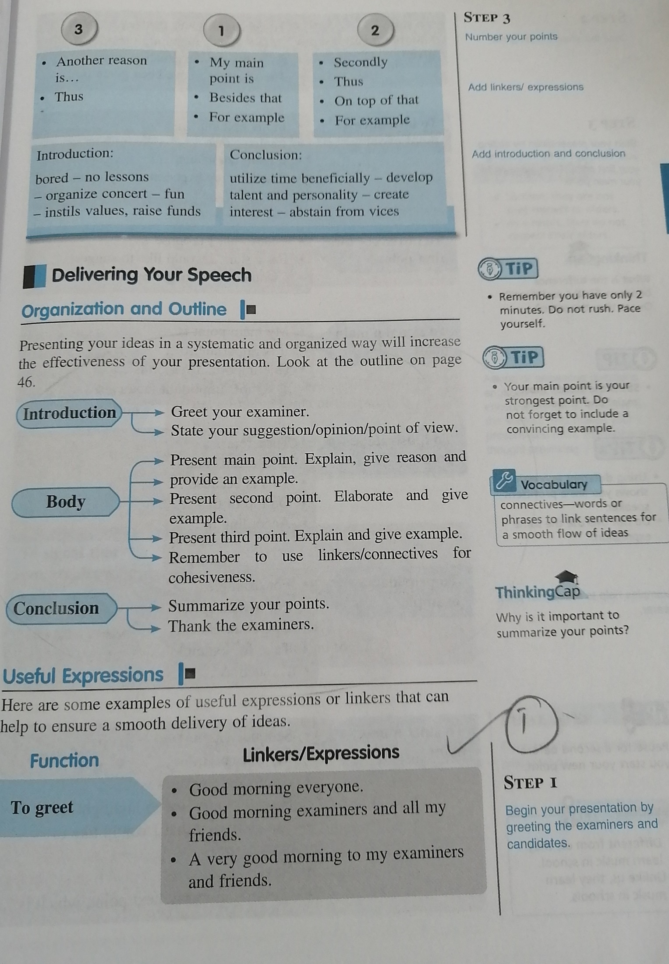

Slide 16
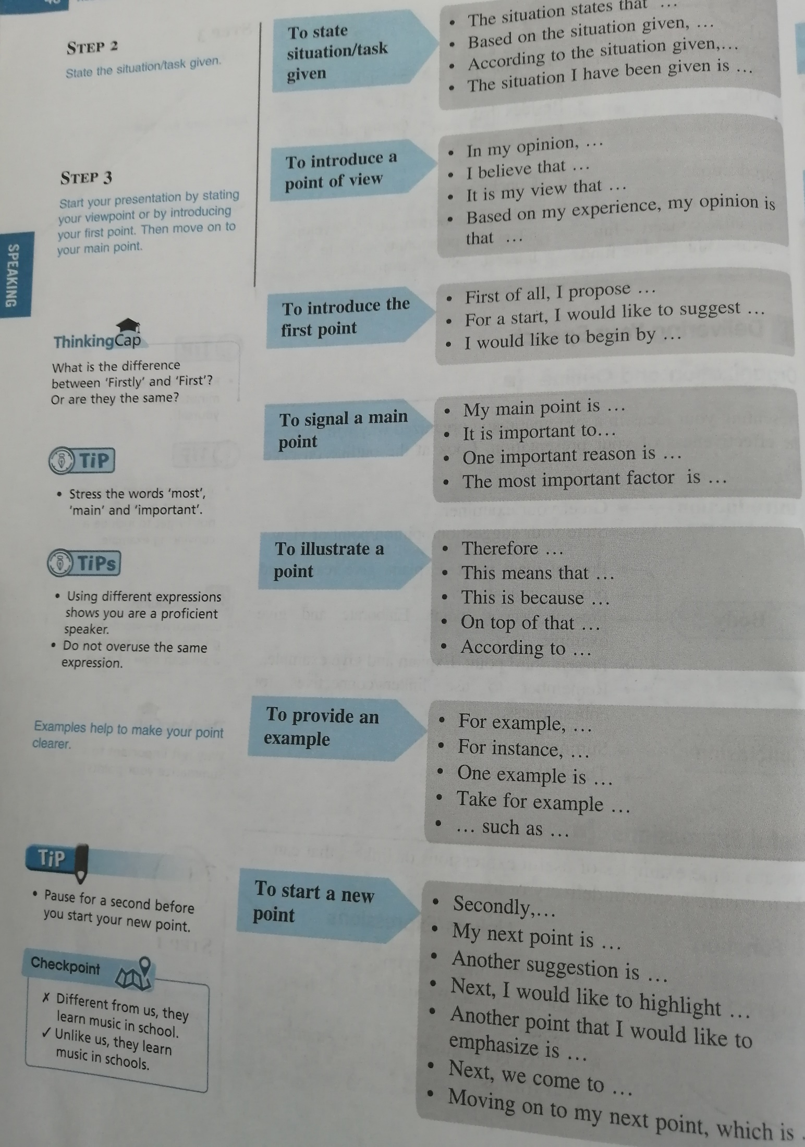

Slide 17
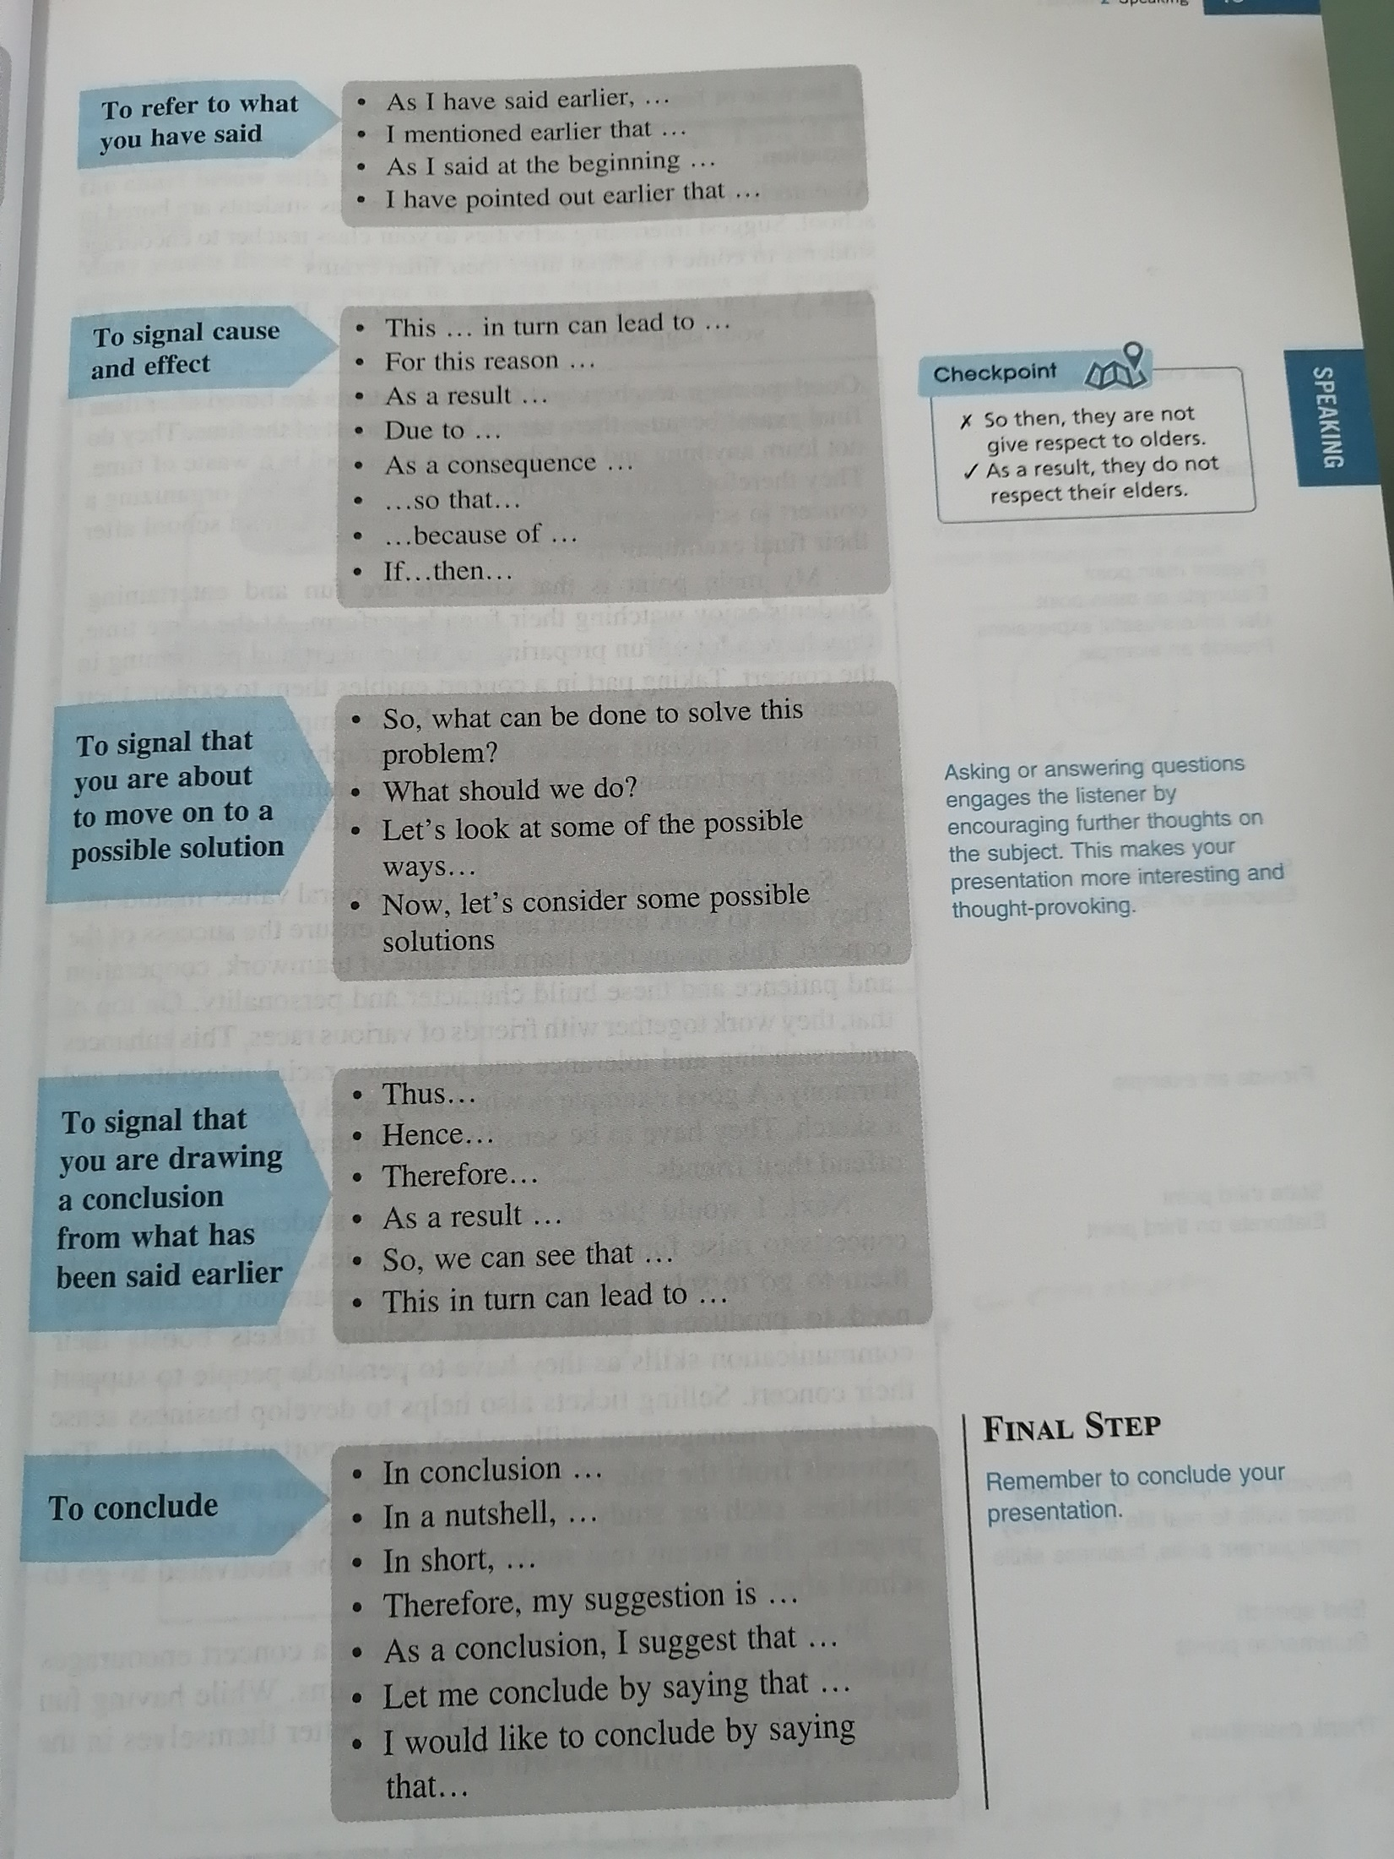

Slide 18
Tips for Effective Speaking
1 Read widely on current issues. Practise preparing points on a topic within 3 minutes and practise speaking. Do not take speaking for granted. You need lots of practice!
2 Be calm and confident. Sit upright, smile and use appropriate gestures.
3 Articulate clearly with proper pitch and intonation. Do not speak too fast or pause too long.
4 Observe social conventions. Be polite and diplomatic. Be willing to accept better suggestions. Do not get personal or defensive.

Slide 19
Tips for Effective Speaking
5 Pay attention. Listen attentively and focus on the topic. Do not daydream.
6 Be an active participant. Interrupt politely where necessary. Do not keep quiet or monopolize the discussion.
7 Keep within the stipulated time. Allocate sufficient time for each point. Do not spend too much time on the introduction and the first point (the FIRST speaker-don’t take too long)
8 Organize ideas using keywords. Give practical opinions, reasons and examples. Do not give sweeping statements or generalizations.

Slide 20
CLOSING TIPS
Three candidates agree on one of the arguments
In conclusion, most of us agree that exercising moderately is the most effective way to overcome stress. Thank you for your attention.

Slide 21
CLOSING TIPS
2 candidates agree on one argument while the other 2 candidates agree with another argument
To conclude we are unable to come to a group decision because some of us believe that exercising moderately is the most effective way to overcome stress. The rest of us, on the other hand, are of the opinion that good time management is the best way to overcome stress (because we can get things done in a systematic manner so that work does not accumulate overtime). Thank you

Slide 22
CLOSING TIPS
All 4 candidates hold strongly to their individual; arguments. Cannot agree on one argument
We are unable to come to an agreement on the most effective way to overcome stress. Thank you.
All of us believe in our own views though we agree with some of the arguments presented. Thank you.

Slide 23
Sample question
Your friend wants to quit university because her family is facing a financial crisis. Advise her.
Study part-time
Study full-time
Postpone studies for 1 year
Continue studying but start an online business

Slide 24
Study part-time Study full-time Postpone for 1 year Continue studying but start an online business
SAMPLE ANSWER
Discuss the best advice for her.
A: A wonderful morning to one and all. The issue we are discussing today is our friend wants to quit university due to a financial crisis that her family is facing. I would like to invite anyone of you to kickstart this discussion by giving us your opinion.
B: Allow me to begin. First and foremost, I am very worried about our friend when I received the news that she wants to quit university. Hence, I decided to give her a piece of advice. In my humble opinion, I believe that studying full time is a good way for her. This is because she will achieve better results if she focuses only on her studies. For instance, she can be on the dean’s list when she works hard for it.
C: I see your point but how about she postpones her studies for one year. In this way, she will be able to help her family with the financial problem. The reason is because she can focus on earning money instead of worrying and being unable to focus in class.
D: I do not quite agree with you because by doing so, she will graduate later than she is supposed to. I think that it will be better if she studies but start a business online. Does anyone agree with me?

Slide 25
Study part-time Study full-time Postpone for 1 year Continue studying but start an online business
A: Yes, I do agree (why) but allow me to share my point. I think that she should study part time. My reason for this is because she can work part time while studying to earn some money to pay for her tuition fees, books, accommodation and so on.
C: I am afraid that I do not see eye to eye with both of you. Those solutions are not the best way to solve her problems. Mainly because she might end up repeating her papers and will have another incurred fees. Thus, it will actually burden her family and herself more.
B: Indeed, I do see your point of view but I believe that she should just continue her studies full time because she can also apply for a scholarship or study loan(example:PTPTN) by using her first semester’s result. In order to make it happen, she needs to get a very good result which I encourage her to just focus on her studies.
D: That is an interesting perspective and I agree with you that she should apply for a scholarship or loan. However, I think that we should consider other points. In my perspective, doing an online business is very simple and saves a lot of cost. She does not have to rent for a shop nor spend a lot on transportation fees. Wouldn’t you agree?
Notes:
25

Slide 26
Candidate A: Study part-time Candidate B: Study full-time Candidate C: Postpone for 1 year Candidate D: Continue studying but start an online business
A: I am not sure I understand what you are saying. Can you explain it again, please?
D: What I mean is she can study and do business online at the same time. The main reason for this is because it is very simple, easy, convenient and fast. Nowadays people can access the internet from anywhere they are. She would not need to spend money on rental and transportations as orders will be made online by using computers, mobile phones, tablets and so on.
A: I see. Yes, I think it would be a great way too. This way she can earn some money even during her studies.
C: That is a good point, but don’t you think that having a gap year for her is better? I strongly believe that this is the best way because she can find a permanent job instead of part time. My reason for this is simply because she will receive a higher salary compared to working part time. Hence, she can save her money worth a year. So candidates A and D, what do both of you think?
D: Now that you have explained it like that, I. also agree that it will be the best way (postpone studies for 1 year). In fact, she can ease the burden of her family if she earns a lot.
I do believe that postponing her studies for a year seems practical and the best way as she can also save some money during that period.

Slide 27
Study part-time Study full-time Postpone for 1 year Continue studying but start an online business
B:Postponing her studies might leave the student feeling left out compared to her friends and can cause stress for the student. It is best if she focuses and studies full time so that she can secure a job sooner and that can help ease her financial burden permanently compared to other short term measures.
A: As for me, I feel that it is the best way compared to all other points if she studies part time because she can also find a sponsorship for her studies. In exchange, she will need to work with the company even during her studies.
C: After listening to all the points on the four choices we have, I think that it is time to make a conclusion.
D: Yes, I think so too.
All: Yes I agree.
B: In short, some of us (candidate D & C) agree that she should postpone her studies for 1 year and the rest of us ( candidate A and B) believe in their own views (though they agree with some of the arguments presented.)
Thank you and have a nice day.

Slide 28
Normal agreement (Not totally agreeing)
How to agree with another point because it is relevant-
but still feel that your point is the best way or best point or best idea
I do agree
That is an interesting perspective and I agree with you.
I think it would be a great way too.
That is a good point, but…
I do see your point of view
What a great idea/wonderful idea (other examples)

Slide 29
Normal agreement examples
I think that is also one of the main causes of smoking.
I agree that it is one of the causes but not the primary cause of cancer.
I feel that _________ is the main cause of stress.
That is one of the negative effects.
I agree it is one of the negative effects of smoking
I feel that poor communication skills is one of the effects of using gadgets compared to other points.

Slide 30
Totally agree examples
I totally / completely agree that ________is the mian cause of cancer
___________ is the worst effect of all other negative effects.
I completely agree with you.

Slide 31
Overall Structure –Turn Taking
Opening
Greet, state topic
Candidate A begins-state point
Candidate B continues
Candidate C continues
Candidate D continues
Maintaining discussion
Candidates continue with second point/agree/disagree/add/provide example/ask questions to other members/ seek clarification or justification/give reasons/mention pros and cons, invite members to speak
Signal closing or conclusion only if you have covered all the points
Closing
Summarise discussion
Conclude…..Example: each had individual point of view/most of them agreed that _____, could not reach a group decision, two of us agreed that ____ and the rest of them have ____
Thank you. (8-12th minute)
Notes:
31

Slide 32
EXERCISE-QUESTION
Many teenagers today are stressed out because of various factors. What do you think is the major cause of stress to teenagers?
Candidate A:In your opinion, family problems are a major cause of stress to teenagers.
Candidate B: In your opinion, School-related problems are a major cause of stress to teenagers.
Candidate C: In your opinion, Boy-girl relationship are a major cause of stress to teenagers.
Candidate D: In your opinion, Financial problems are a major cause of stress to teenagers.
Notes:
32

